Slide 1



AI Agent
Weekly
I. Workflow 1 – Weekly Report
Manually Triggered
Voice or Message Command
Weekly
II. Workflow 2 – Injury Alert
AI Agent
Yearly – End of Season
III. Workflow 3 – Performance Assessment
Schedulled Scenario

Slide 2
Workflow 1
I. Trigger – Start Scenario
II. Fetch Data from Database
III. Text Agregator
IV. OpenAI Module
IV. Update Team Portal
V. Call & Run Subscenario
Schedulled Scenario
Prompt & System Configuration
Weekly Report
Execute Workflow 2

Slide 3
Workflow 2
Secondary Database: Sample Down Weekly Injury Alerts
Benchmark Health and Performance Measures Database
Prompt & System Configuration
I. Trigger – Start Scenario
II. Fetch Data from Database
III. Text Agregator
IV. Fetch Data from Database
V. Text Agregator
VI. OpenAI Module
Schedulled Scenario
Executed via Agent or triggered by Worflow 1
Injury Alerts List
Injury Alerts Database
VIII. Update Team Portal
VII. Add formatted entries to Database
X
XII. Send Detailed Report to Dedicated Personal
XI. OpenAI Module
X. Text Agregator
IX. Fetch Data from Database
Injury Report
Prompt & System Configuration
Weekly Report & Injury Risk Database

Slide 4
Workflow 3
End-of-Season Performance Projection
Secondary Database: Sampled Down End-of-Season Performance Projection
Prompt & System Configuration
I. Trigger – Start Scenario
II. Fetch Data from Database
III. Text Agregator
IV. Fetch Data from Database
V. Text Agregator
VI. OpenAI Module
Schedulled Scenario
Executed via Agent or Manually Triggered
Player Perfomance List
Prompt & System Configuration
IX. Update Team Portal
VIII. Add formatted entries to List
VII. OpenAI Module
X
Player Performance Report
Prompt & System Configuration
XI. Send Detailed Report to Dedicated Personal
X. OpenAI Module

Slide 5
Tabela resultados
Proxy Event | Rank | Model | High-risk Lift (event/non) | Risk Lift (event/non) | Why
Pre-injury-flip (none → non-none next week, persistent) | 1 | Indices_only | 3.227 | 1.481 | Strong positive enrichment, composite indices detect weeks before persistent injury status change
 | 2 | IF_only | 0.839 | 1.002 | No meaningful enrichment, anomaly detection on workload alone doesn’t align well with injury flips
 | 3 | IF_plus_indices | 0.839 | 1.002 | Same as IF_only, adding indices didn’t improve lift here
Pre-gap (gap > 1 week, not a bye, snap-drop on return) | 1 | IF_only | 0.403 | 1.023 | Weak, marginal lift, likely noise, no actionable signal
 | 2 | Indices_only | 0.403 | 1.023 | Weak, same as IF_only, no additional benefit from indices
 | 3 | IF_plus_indices | 0.000 | 0.983 | No signal, combining indices with IF may have diluted sparse signal present in gap proxy

Slide 6

Blockchain
Week
Game 1
Game 2
Game 3
Game 4
...
Year
2025
2024
2023
2022
...
Player Records

Slide 7
DB’s Dataset
Parameter | Description
player_id | Unique identifier for the player
player_name | Full name of the player
age | Age of the player (in years)
position | Player's field position (e.g., LB, DB)
height | Player's height (usually in inches or cm)
weight | Player's weight (usually in lbs or kg)
team | Team the player is currently on
week | NFL week for the data record
games_played | Number of games played this season
solo_tackle | Count of solo tackles made
assisted_tackles | Count of assisted tackles made
sack | Number of quarterback sacks made
qb_hit | Number of hits on the quarterback
interception | Number of interceptions made
fumble_forced | Number of forced fumbles
total_snaps_played | Total snaps the player was on the field
defense_snaps | Snaps played on defense
defense_snaps_% | Percentage of team defensive snaps played
team_defense_snaps | Total defensive snaps by the team
special_teams_snaps | Snaps played on special teams
special_teams_snap_rate | Percentage of special teams snaps played
seasons_played | Total seasons the player has played
active_or_inactive | Whether the player is active or inactive that week
game_surface | Type of playing surface (e.g., turf, grass)
weather_temperature | Temperature during the game
previous_injury | Whether player had an injury in the past
body_injury | The location/type of past injury
weeks_played_consecutively | Number of consecutive weeks played
index_defensive_effort | Metric for player’s defensive performance effort
fatigue_index | Measure of player fatigue level
injury_next_week? | Whether the player is predicted to be injured next week

Slide 8
Offensive players Dataset
Parameter | Description
player_id | Unique identifier for the player
player_name | Full name of the player
position | Player's playing position (e.g., WR, RB)
season | NFL season year for the data record
team | Team the player is playing for
age | Player’s age (in years)
games_played | Number of games the player has played in the season
season_receiving_yards | Total receiving yards in the season
season_yards_after_catch | Yards gained after the catch
season_rush_attempts | Total rushing attempts in the season
season_rushing_yards | Total rushing yards in the season
season_tackled_for_loss | Times tackled behind the line of scrimmage
season_rush_touchdown | Total rushing touchdowns scored
season_interception | Total interceptions thrown
season_fumble | Total fumbles committed
season_receptions | Total receptions made
season_targets | Total times the player was targeted
season_receiving_air_yards | Total air yards on receptions
season_receiving_touchdown | Receiving touchdowns scored
season_fantasy_points_ppr | Total PPR fantasy points scored
season_total_tds | Total touchdowns scored (all types)
season_touches | Total touches (rush + receptions)
season_total_yards | Combined rushing and receiving yards
season_offense_snaps | Total offensive snaps played
season_team_offense_snaps | Total offensive snaps by the team
team_contribution | Player’s share of team offensive output

Slide 9
Justin Hilliard Dataset
Parameter | Description
kCal_Out | Total calories burned (kcal)
Sodium | Amount of sodium consumed (mg)
kCal_In | Total calories consumed (kcal)
Carbs | Total carbohydrate intake (g)
In_bed_duration | Total time spent in bed (minutes)
totalSleep | Total time spent sleeping (minutes)
Iron | Iron intake (mg)
Vitamin_A | Vitamin A intake (mcg)
Calcium | Calcium intake (mg)
Vitamin_C | Vitamin C intake (mg)
maxHR | Maximum heart rate recorded (bpm)
Potassium | Potassium intake (mg)
averageHR | Average heart rate (bpm)
Light_sleep_duration | Time spent in light sleep (minutes)
Sugar | Total sugar intake (g)
Fats | Total fat intake (g)
HRV | Heart rate variability (ms)
REM_Duration | Time spent in REM sleep (minutes)
Deep_SWS_duration | Time spent in deep (slow-wave) sleep (minutes)
Protein | Total protein intake (g)
Strain | Physical strain or exertion score
saturatedFat | Saturated fat intake (g)
awakeDuration | Time awake during the night (minutes)
Overall | Overall recovery or wellness score
RPE | Rate of perceived exertion (0–10 scale)
Cholesterol | Total cholesterol intake (mg)

Slide 10
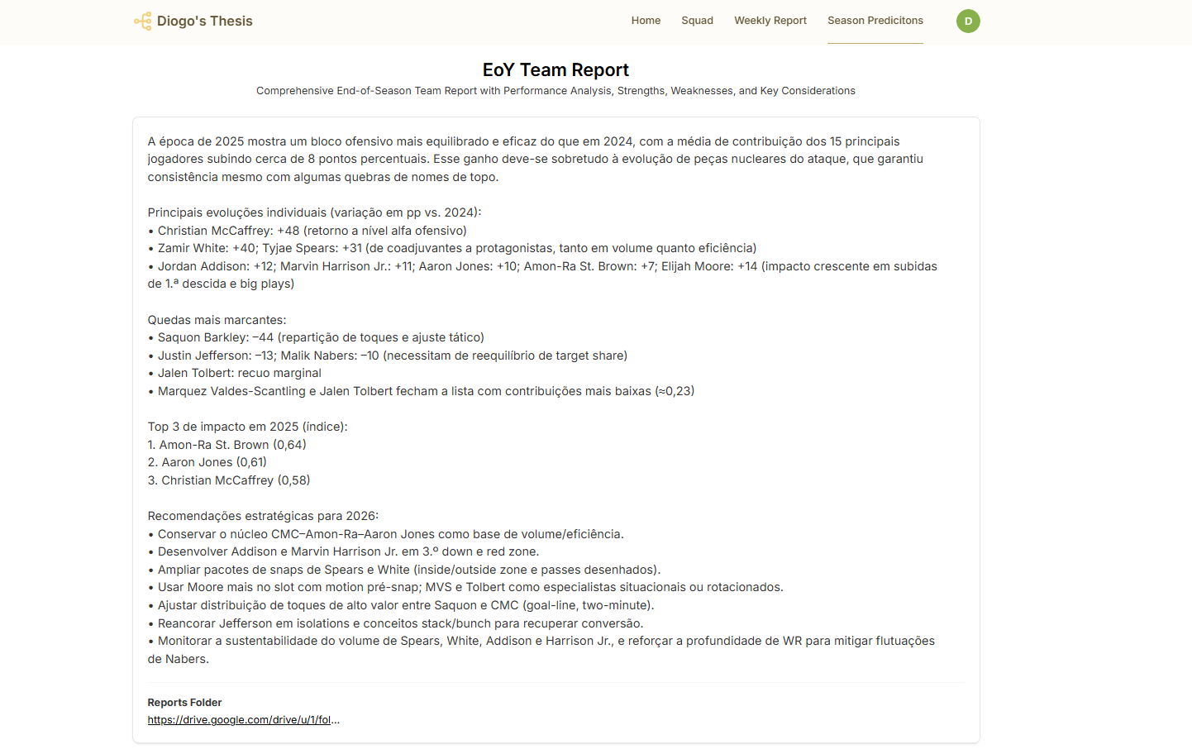
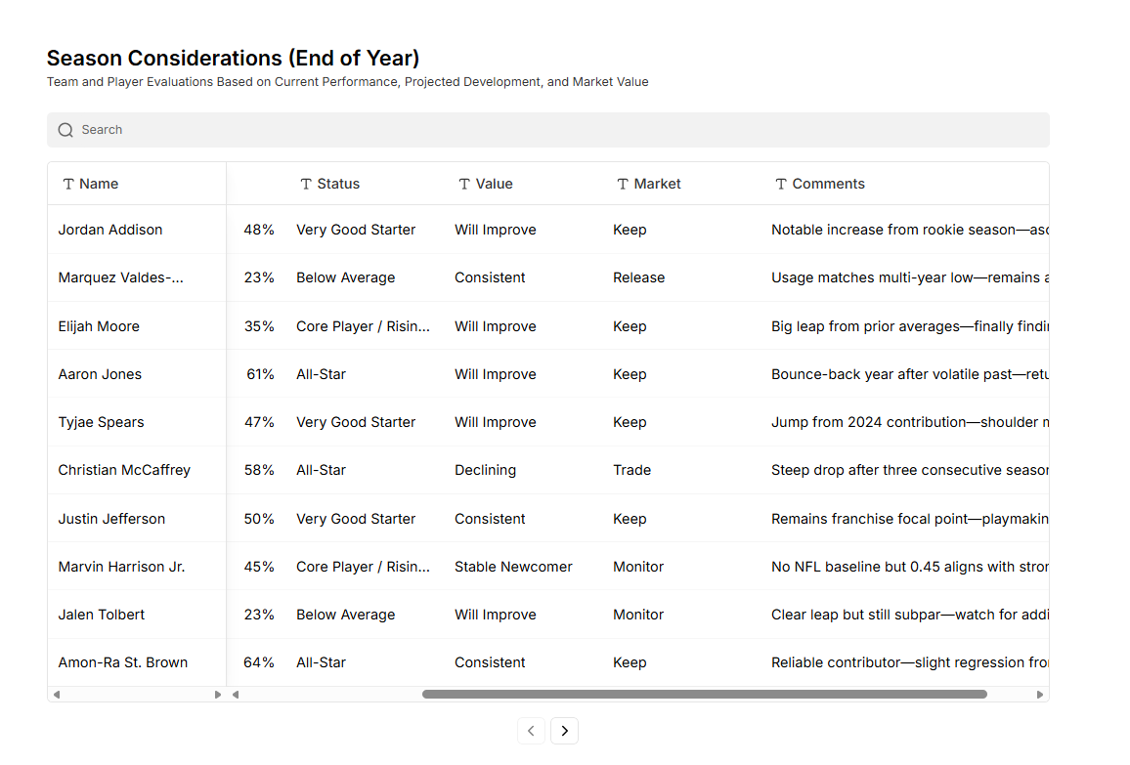

Slide 11
